Slide 1
Income Elasticity of Demand

Slide 2
Types of Income Elasticity of demand
1. Positive income elasticity of demand (EY>0)
– Income elasticity greater then unity (EY > 1)
– Income elasticity equal to unity (EY = 1)
– Income elasticity less then unity (EY < 1)
2. Negative income elasticity of demand ( EY<0)
3. Zero income elasticity of demand ( EY=0)

Slide 3
1. Positive income elasticity of demand (EY>0)
If the quantity demanded for a commodity increases with the rise in income of the consumer and vice versa, it is said to be positive income elasticity of demand.
For example: As the income of consumer increases, they consume more of superior (luxurious) goods.

Slide 4
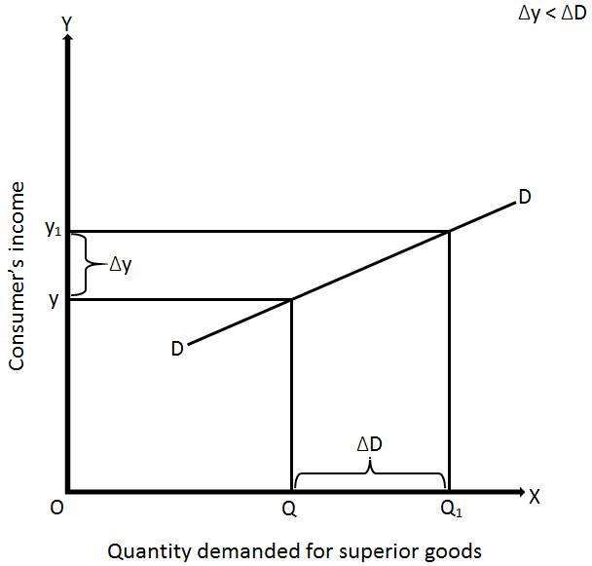
Income elasticity greater then unity (EY > 1)
Percentage change in quantity demanded for a commodity is greater than percentage change in income of the consumer, it is said to be income greater than unity. In case of LUXURIES, the coefficient of income elasticity is POSITIVE but high, Ey > 1. Assuming prices of all other goods as constant, if the income of the consumer increases by 5% & as a result his purchases of the commodity increase by 10% .
Ey =10/5= 2(>1)
INCOME DEMAND IS ELASTIC

Slide 5
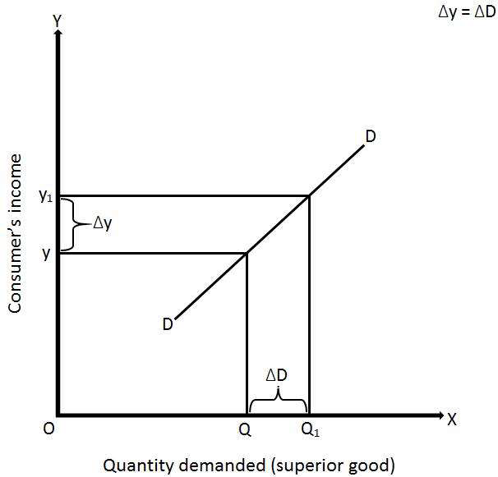
Income elasticity equal to unity (EY = 1)
Percentage change in quantity demanded for a commodity is equal to percentage change in income of the consumer. COMFORTS.The coefficient of income elasticity is unity Ey= 1
A 5% increase in income leads to 5% rise in demand, Ey=5/5= 1

Slide 6
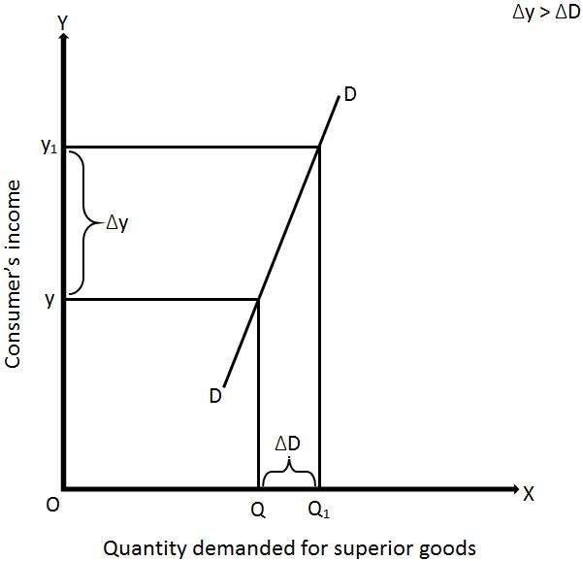
Income elasticity less then unity (EY < 1)
Percentage change in quantity demanded for a commodity is less than percentage change in income of the consumer. The coefficient of income elasticity is positive but LOW, Ey <1.
If the proportion of income spent on a commodity increases by 2% when the consumer’s income goes up by 5%, Ey =2/5= 0.4(<1)
INCOME DEMAND IS INELASTIC

Slide 7
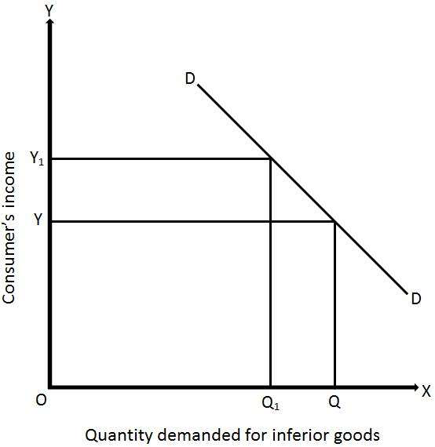
2. Negative income elasticity of demand ( EY<0)
Quantity demanded for a commodity decreases with the rise in income of the consumer and vice versa. The coefficient of income elasticity of demand in case of inferior goods is NEGATIVE. In this case , the consumer will reduce his purchases of it, when his income increases.
Ex : An increase in income might lead to shift his demand fro bidies to cigarettes

Slide 8
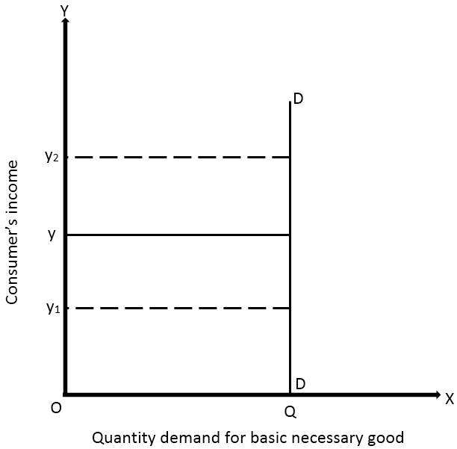
3. Zero income elasticity of demand ( EY=0)
Quantity demanded for a commodity remains constant with any rise or fall in income of the consumer. If with an increase in income , the quantity demanded remains unchanged, the coefficient of income elasticity, Ey =0.Ex. Salt

